Slide 1
Gwms pda USER manual

Slide 2
Container management

Slide 3
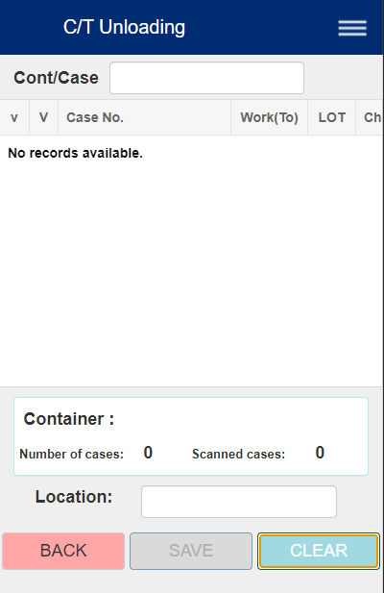
c/t unloading
Uses:
Unload each case in the container coming from shipping
Record cases that may be missing (shortage) and extras (overage)
1. To get started:
Scan a CONTAINER's barcode. If CONTAINER's barcode is valid, a list of cases should appear.
If no such container exists, then the message will appear:
"Container info does not exist"
Scan input for container or case
Container content info table
Container number, content info pane
Scan input for destination storage location code

Slide 4
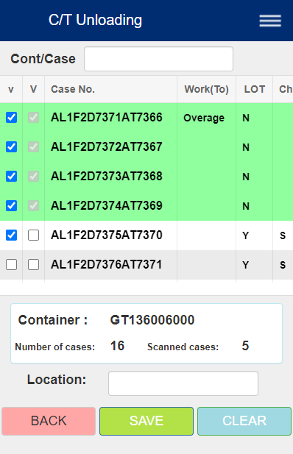
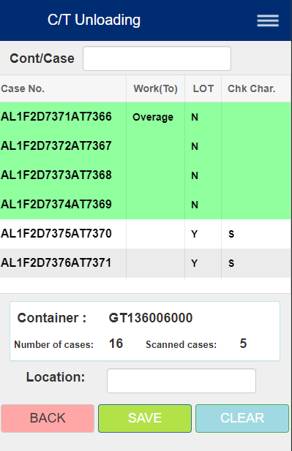
2. Scan cases
For new cases in container (2nd column is checked, Work(To) is empty)
Scan each case's barcode
If Case has LOT label ("Y" to LOT)
Scan its lot check code right after (should be same with Chk Char.)
Attempting to scan another case will result in "Invalid Lot Barcode" message
Scanned Cases (and LOT labels if applicable) should be highlighted green
IMPORTANT: Do NOT uncheck, or both columns will be marked unchecked
Overage cases
Scanning Case barcode not in list will add case to table, marked "Overage" to the Work(To) column
If case does not have LOT label ("N" to LOT)
Simply scan the case's barcode
As with new cases, DO NOT uncheck
If case has LOT label ("Y" to LOT)
Scan case's barcode, then its lot check code right after (should be same with Chk Char.)
Attempting to scan another case will result in "Invalid Lot Barcode" message
Indicates whether overage case's lot check code is scanned, if exists
Indicates whether case has LOT label or not
Indicates whether it was scanned
"Overage" only if case was not part of container
Lot check code
Num cases found (not including overages)
Num cases marked scanned (including overages)

Slide 5
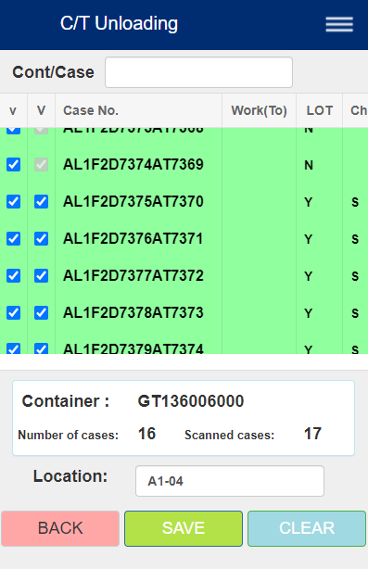
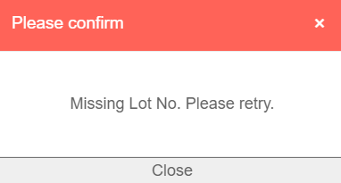
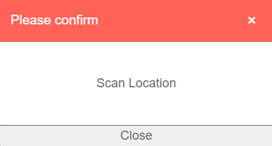
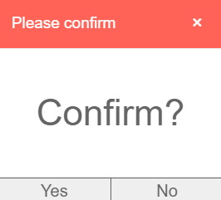
3. SAVE
If you are finished scanning:
Make sure that for each case:
If marked scanned (checked in first column), second column must also be marked checked. Otherwise, attempting to SAVE will result in message "Missing Lot No. Please retry".
If not marked scanned, but second column is checked, you can still scan case again if possible
Scan for Location code, if not done already. Otherwise, attempting to SAVE will result in message "Scan location".
Click SAVE to save data.
If there are ANY cases are:
Not marked "Overage" but not scanned (Shortage)
You will receive a warning of any cases in shortage, then it will ask you if you want to continue. If you press "No", you can go back and continue scanning.
If SAVE is successful, the screen will indicate success. Otherwise, it will indicate failure.
Press CLEAR to continue with another container or try again if SAVE failed.
At least one Case's LOT label is not scanned (if applicable).
Please go back and scan the Case's LOT label as needed.
Location was not scanned.
Please scan location.
Press "Yes" to proceed in case of shortage

Slide 6
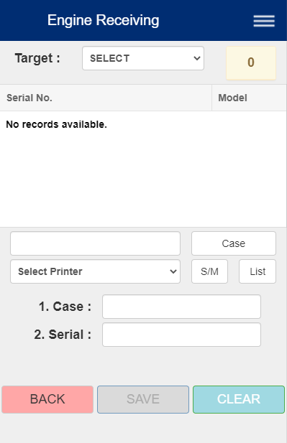
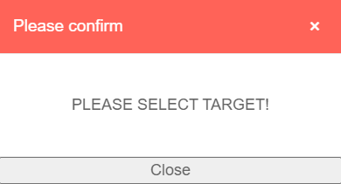
Engine receiving
Uses:
Generate new case number for each of the scanned serial numbers listed on table
Verify match between case and serial (if a case exists)
1. To get started:
Choose target CC from the Target dropdown
Doing anything else before this will result in following message:
Next, scan either an Engine Serial No or a Case No

Slide 7
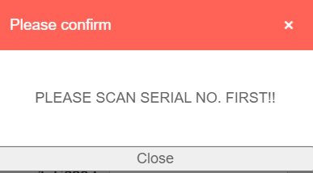
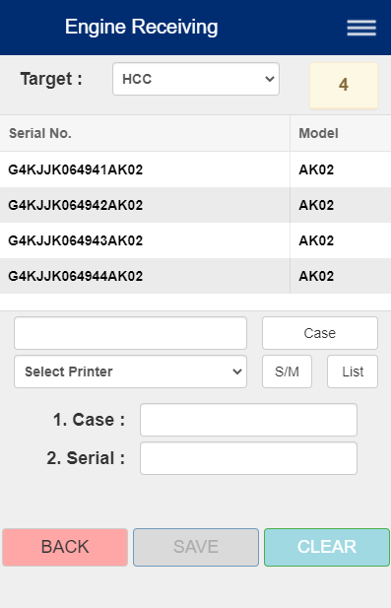
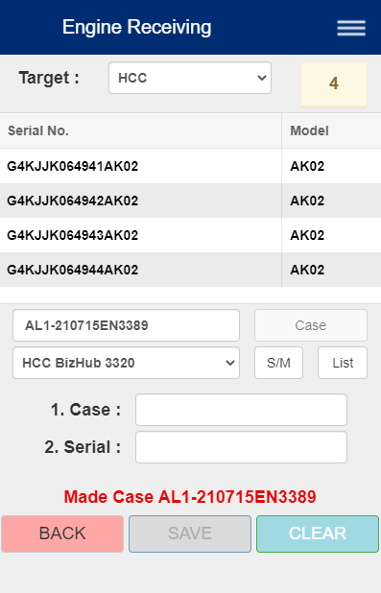
2a. To generate case numbers for each of scanned serial numbers:
Scan ALL the engine serial barcodes as needed.
Click the Case button to generate case. The generated case number will then appear.
Pressing Case before scanning an Engine Serial Number will result in the message: "PLEASE SCAN SERIAL NO. FIRST!!"
Next, select printer from the Printer dropdown (list changes depending on Target CC) and click either S/M (barcode labels) or List (a page listing cases) to print. You are not able to print until Serial Nos are scanned, and Case number is generated by pressing Case.
Important:
If a Case barcode is scanned first instead of Engine Serial No, go to Step 2b instead.
(Continue next page...)
List of serial numbers scanned
The generated case number will appear here when you click Case
Select Printer, and press either S/M or List

Slide 8
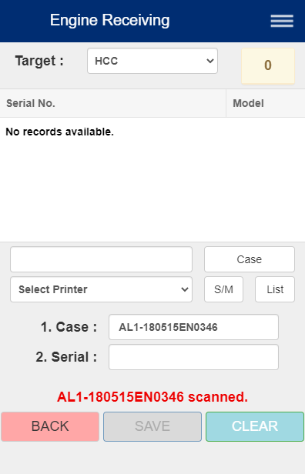
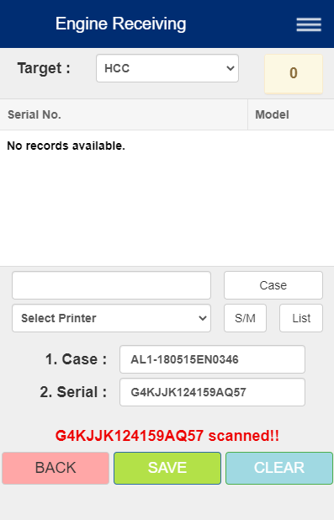
2b. To verify match between case and serial:
First, scan an Engine Case barcode. Next, scan the matching Serial No.
If case number and serial number do not match, you will receive an error message.
If match is successful:
You can press SAVE to record and save log in Step 2c. If match is unsuccessful:
Screen will display message like:
"… SERIAL AND CASE NUMBER DO NOT MATCH, PLEASE CHECK!"
Please scan Engine Serial again that match with Case No.
2c. SAVE
Press SAVE to record and save log.
The screen will attempt to save and indicate either success or failure. If unsuccessful, the screen will display message indicating failure.
The SAVE button and scanning will be disabled.
Press CLEAR to reset and continue or try again.

Slide 9
Case management

Slide 10
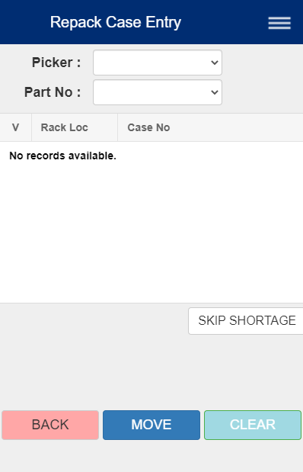
REPACK CASE ENTRY
Picker, Part No dropdowns
Uses:
Check and confirm parts for Repacking process
1. To get started:
Select Picker then Part No from the dropdowns.
If there is a matching order, it will be displayed on the table.
Case table

Slide 11
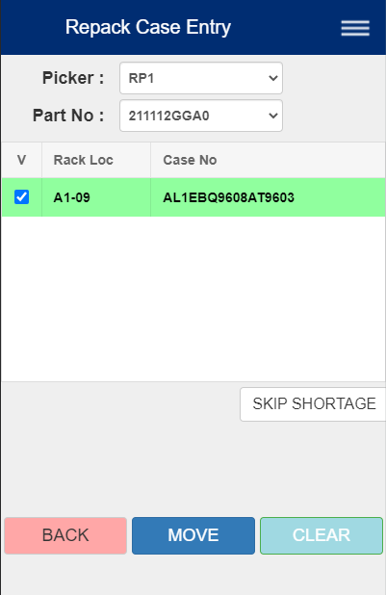
2. Repack Orders
The table will display:
Whether case is scanned
Rack location
Case number
Scan correct case's barcode, which will mark it scanned (highlighted green). Scanning an incorrect case will result in error message.
You can manually uncheck a scanned case, but you must scan case again to mark it scanned again.
When you are done, press either the SKIP SHORTAGE or the MOVE button.
Press this if case is missing
Press this after scanning ALL of the cases

Slide 12
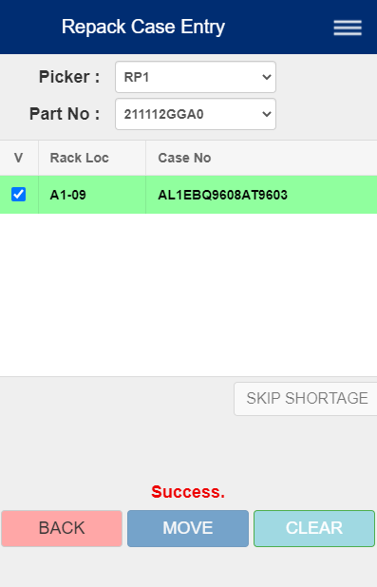
3. SKIP SHORTAGE/MOVE
IMPORTANT: Pressing MOVE without scanning the case with result in error message, as MOVE requires that the case be marked scanned.
Press SKIP SHORTAGE ONLY IF the case displayed is missing.
If you press SKIP SHORTAGE, the display will ask you to confirm Skip. If you press "No", you can return to scan case.
Press either button will disable both buttons. The display will indicate whether SKIP/MOVE was successful or not.
Press the CLEAR to reset screen.

Slide 13
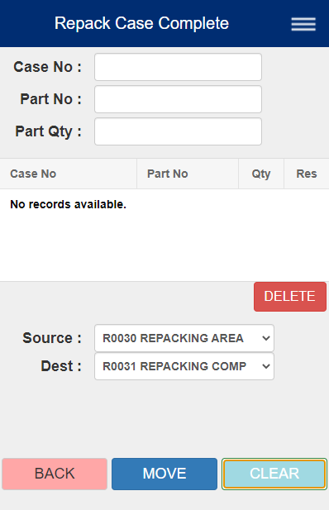
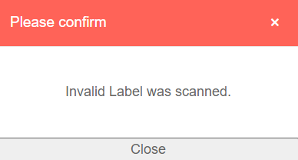
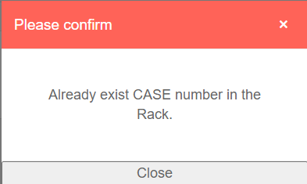
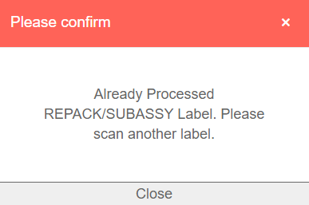
REPACK CASE COMPLETE
Scan inputs:
Case number
Part number
Part quantity
Uses:
Check and confirm a case for moving from Repacking Area to Repacking Complete area for completion of Repack process.
1. To get started:
Scan a case's barcode.
If case barcode is accepted, then the scanned case's info will be displayed on the table below.
Otherwise, you will get any of the error messages below:
Case table
Select source and destination

Slide 14
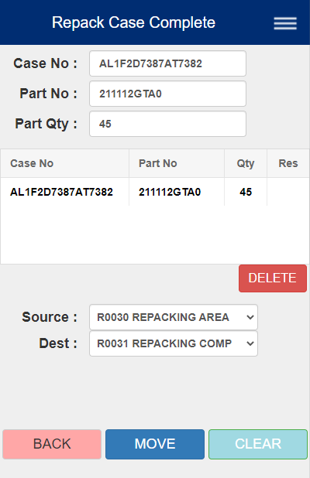
2. After scanning case
If the PDA accepts the case barcode, the screen will display a single row including:
Case number
Part number
Part quantity
NOTE: The table will only display a single case. Scanning another one before clearing will yield a message "One case only."
To display another case, either:
Select the row (will turn red) and press DELETE.
OR press CLEAR
Then, scan another case.
Then, select Source and Destination from the two dropdowns, although they will be selected from the start.

Slide 15
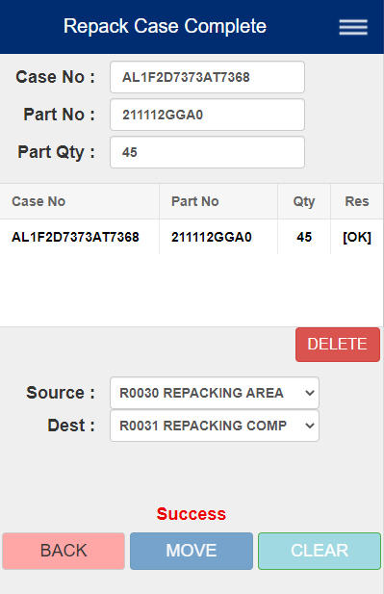
3. Save
After scanning case and selecting the Source and Destination, press the MOVE button to save data.
If any of the fields are missing, you will get an error message.
Regardless of outcome, the MOVE button will be disabled.
The status of the MOVE will be displayed in the Res column in the table, telling whether the move is successful or not.
Then, press the CLEAR button to reset the screen to continue.
Required fields
Indicates whether the MOVE was successful ("OK" or "Fail")

Slide 16
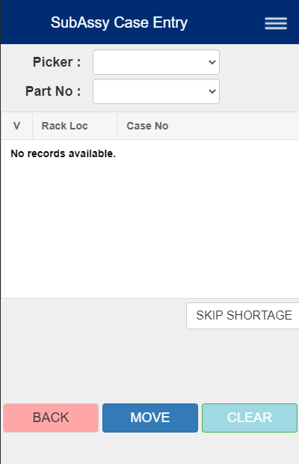
SUBASSY CASE ENTRY
Picker, Part No dropdowns
Uses:
Check and confirm parts for Sub-assy process
1. To get started:
Select Picker then Part No from the dropdowns.
If there is a matching order, it will be displayed on the table.
Case table

Slide 17

2. Subassy Orders
The table will display:
Whether case is scanned
Rack location
Case number
Scan correct case's barcode, which will mark it scanned (highlighted green). Scanning an incorrect case will result in error message.
You can manually uncheck a scanned case, but you must scan case again to mark it scanned again.
When you are done, press either the SKIP SHORTAGE or the MOVE button.
Press this if case is missing
Press this after scanning ALL of the cases

Slide 18

3. SKIP SHORTAGE/MOVE
IMPORTANT: Pressing MOVE without scanning the case with result in error message, as MOVE requires that the case be marked scanned.
Press SKIP SHORTAGE ONLY IF the case displayed is missing.
If you press SKIP SHORTAGE, the display will ask you to confirm Skip. If you press "No", you can return to scan case.
Press either button will disable both buttons. The display will indicate whether SKIP/MOVE was successful or not.
Press the CLEAR to reset screen.

Slide 19
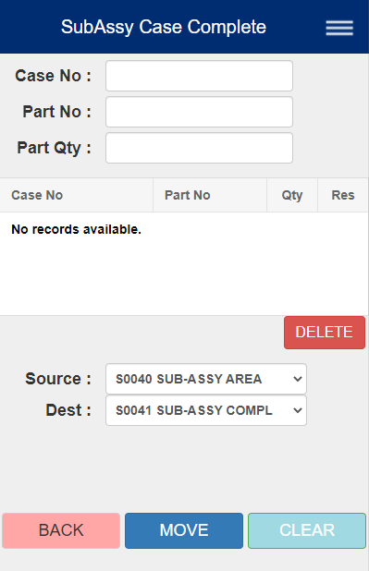
SUBASSY CASE COMPLETE
Scan inputs:
Case number
Part number
Part quantity
Uses:
Check and confirm a case for moving from Subassy Area to Subassy Complete area for completion of Sub-assy process.
1. To get started:
Scan a case's barcode.
If case barcode is accepted, then the scanned case's info will be displayed on the table below.
Otherwise, you will get any of the error messages below.
Case table
Select source and destination

Slide 20

2. After scanning case
If the PDA accepts the case barcode, the screen will display a single row including:
Case number
Part number
Part quantity
NOTE: The table will only display a single case. Scanning another one before clearing will yield a message "One case only."
To display another case, either:
Select the row (will turn red) and press DELETE.
OR press CLEAR
Then, scan another case.
Then, select Source and Destination from the two dropdowns, although they will be selected from the start.

Slide 21

3. MOVE
After scanning case and selecting the Source and Destination, press the MOVE button to save data.
If any of the fields are missing, you will get an error message.
Regardless of outcome, the MOVE button will be disabled.
The status of the MOVE will be displayed in the Res column in the table, telling whether the move is successful or not.
Then, press the CLEAR button to reset the screen to continue.
Required fields
Indicates whether the MOVE was successful ("OK" or "Fail")

Slide 22
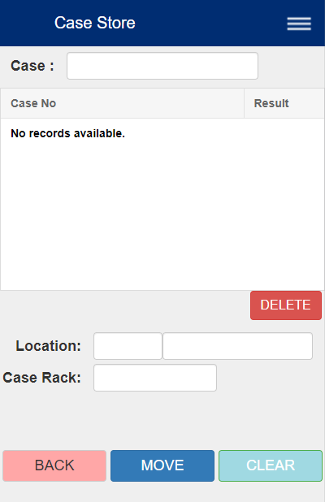
CASE STORE
Uses:
Move scanned cases to another location indicated by Location and Case Rack. Note that you are not allowed to move cases located in the OSD Inventory or Inventory Hold Area.
1. To get started:
You can either
Scan rack location barcode (destination)
Scan a case If valid, the case number will be added to table. Otherwise, a message will pop up on display, prompting you to try again or scan another case
Case input
Scanned case table
Location input

Slide 23
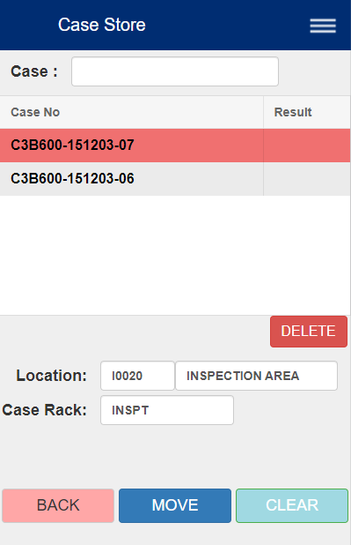
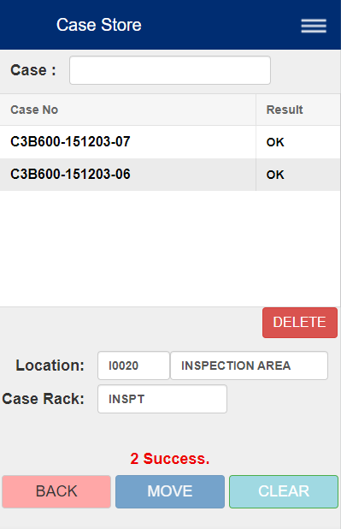
2. Scan Cases
Scan cases to be moved to a desired location.
To remove case from table: Tap on a case (highlights row red) , then tap DELETE
If you have not already, scan location code, the destination for the scanned cases. This will fill the Location and Case Rack input boxes.
3. Save data
If finished scanning cases and destination location, press MOVE to save data. Note that tapping it will disable the button.
The screen will display whether the action is successful or if there is at least one case that failed.
Reset screen with CLEAR to continue with other cases or to try again if MOVE was not successful.
Tap on a row, then press DELETE to remove case from table

Slide 24
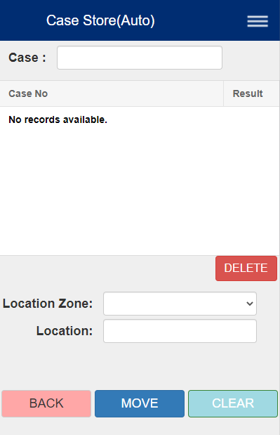
CASE STORE (AUTO)
Uses:
Move and store cases to another location indicated by Location Zone and Case Rack Location. Where the cases can be moved will depend on the cases' vendor numbers.
1. To get started:
You can either
Scan rack location barcode (destination), then scan cases
Scan cases first
Case input
Scanned cases table
Location input

Slide 25
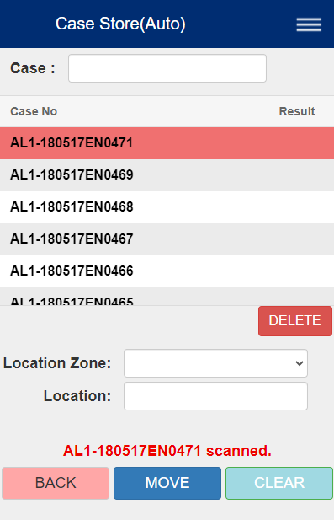
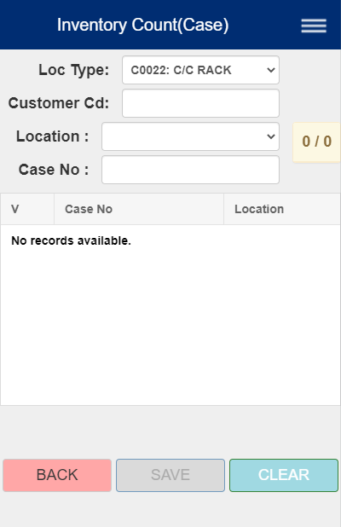
2. Scan cases
Important: Make sure the cases scanned all have the same vendor number! The selections on Location Zone dropdown will appear depending on the cases' vendor numbers.
Next, select Location Zone from the dropdown.
To remove case from table: Tap on a row, highlighting red. Then, press DELETE to remove the selected case.
Next, if you have not already, scan desired location code. If accepted, it will fill Location. Otherwise, it will display message "The Case does not match Location No."
3. MOVE
If finished scanning cases and Location, press MOVE to save data. This will disable the button once pressed. The display will indicate whether saving is successful or not.
Press CLEAR to reset screen and continue.
Tap on a row, then press DELETE to remove case from table
Scan location code, which will fill in the location.

Slide 26
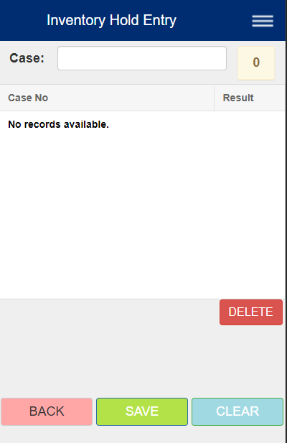
INVENTORY HOLD ENTRY
Case number input
# Cases scanned
Uses:
Check and confirm cases entering warehouse for transporting to Inventory Hold Area
1. To get started:
Scan a case's barcode. If valid, the table will display its Case number.
Case table

Slide 27
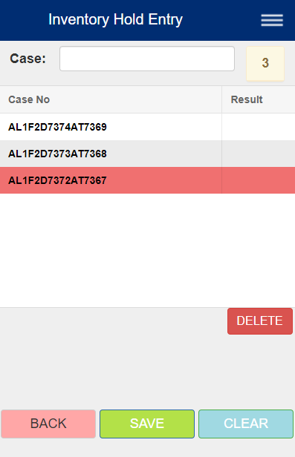
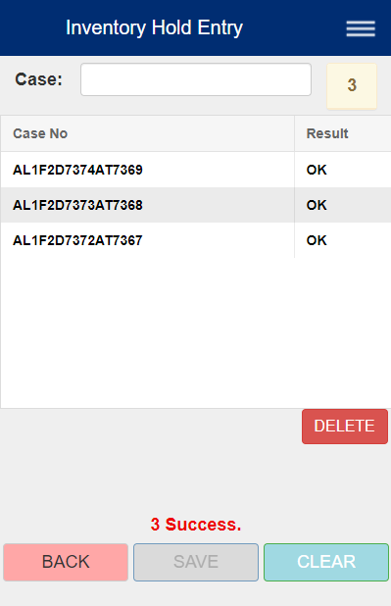
To remove case from table:
Click on a case. he row selected will be highlighted red. Click the row again to unselect it.
Click the DELETE button to delete highlighted row.
2. Saving
After you finish scanning, press the SAVE button to save data. The table must be not empty. The SAVE button will also be disabled.
The screen will display whether the SAVE is successful for each case with "OK" or "Fail".
If successful, reset screen with CLEAR to continue.
Otherwise, the screen will display a message informing failure.
After pressing SAVE, each case will have either "OK" or "Fail"

Slide 28
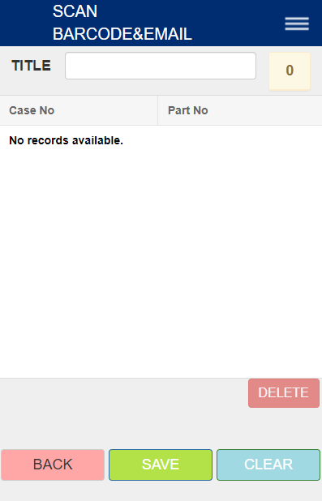
Scan barcode & email
Title input
# cases scanned
Uses:
Send email containing information of cases scanned and on list:
Case number
Part number
Barcode
1. To get started:
Type title on TITLE or scan a case
NOTE: You will be unable to scan for cases while you are typing TITLE.
List of cases scanned

Slide 29
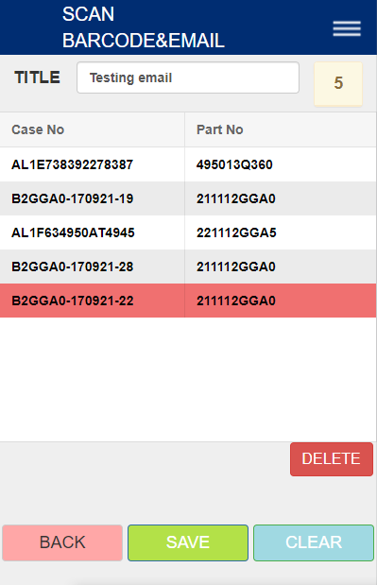
2. Scan Cases
Scanned cases will be listed on table. To remove one from list:
Tap on a row. The row selected will be highlighted red. Click the row again to unselect it.
Click the DELETE button to delete highlighted row.
3. Send email:
First, ensure that:
TITLE is NOT empty
List of cases is NOT empty
Attempting to send email with one of the fields empty will yield an error message.
Press the SAVE button to send email.
If sending email is successful, the screen will display a message indicating success.
Then, press CLEAR to reset screen and continue.

Slide 30
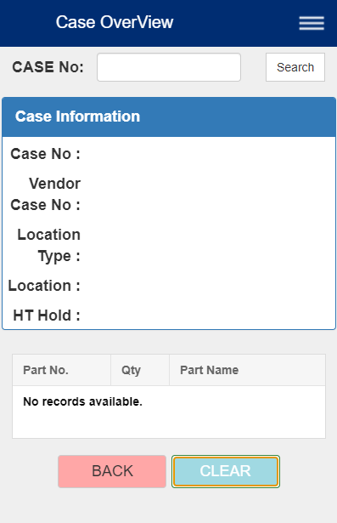
Case overview
You can also manually enter Case # and click Search
Uses:
Look up a detailed overview of a case based on Case No., which includes:
Case No.
Vendor Case No.
Location No. And Name
HT Hold status
Part No., quantity, and name in Case
Case No. Search bar
Case Information Pane
Parts in case info table
Go back to
Case Mgmt menu
Reset screen

Slide 31
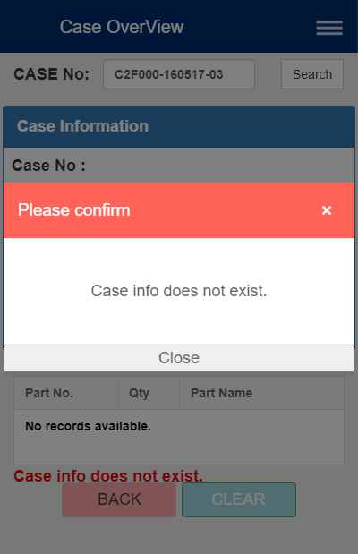
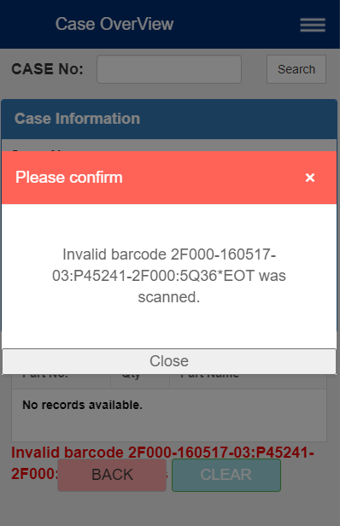
To get started:
Scan the Case's barcode
You can also manually type in the Case # and hit Search
If barcode/Case # is valid and it exists, you will see a screen with detailed case information. Otherwise, you will get either of the two screens:
Barcode is valid, but case does not exist.
Barcode is invalid.

Slide 32
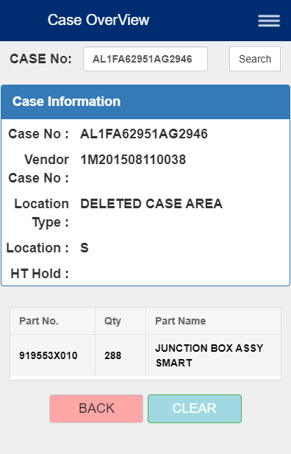
If barcode/Case # is valid and it exists, you will see the following screen, which will contain:
Case number
Vendor Case number
Location name and code (Location Type, Location)
HT Hold status (may be empty)
Part number, quantity, and name in case
If finished, press CLEAR or scan another case.
You can also manually enter Case # and click Search

Slide 33
shipping

Slide 34
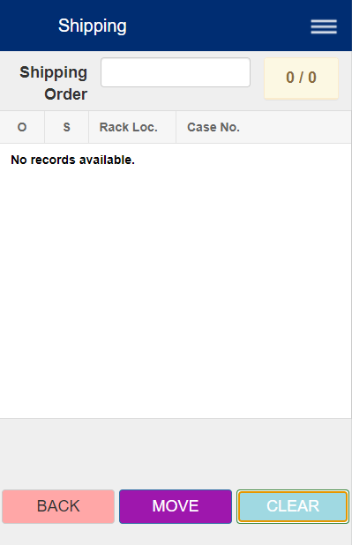

shipping
# cases marked scanned
# cases found
Uses:
Confirm all cases in shipping order described by shipping number for shipping to another destination
1. To get started:
Scan shipping order barcode If barcode is valid and shipping order is not empty, the screen will display a table of cases. Otherwise, it will display an error message.
Shipping order number input
Table of cases in shipping order

Slide 35
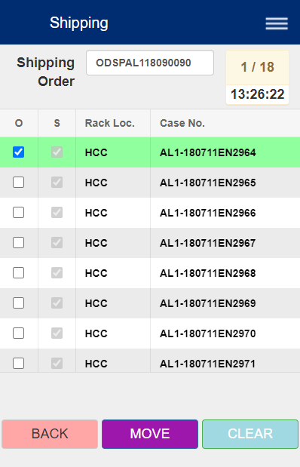
For each row in table:
Whether it was scanned (marked with check)
If case is a shipping case: whether its shipping label was scanned. Otherwise, it is always checked and uncheckable
Rack location
Case number
2. Scanning Cases
For shipping cases (cases with "S" column enabled):
Scan case's barcode, then its shipping label Note: Attempting to scan another case after scanning the shipping case will result an error message
For other cases: Simply scan case's barcode.
NOTE:
For all cases: You can manually uncheck scanned cases (first column), but you must scan case again to mark it scanned.
For shipping cases: If you uncheck the second column, you must also uncheck the first column. Then scan case's barcode and shipping label.
Time last scanned case
Rack location code
Ship label scanned indicator (for shipping cases only)
Scanned indicator
Case number

Slide 36
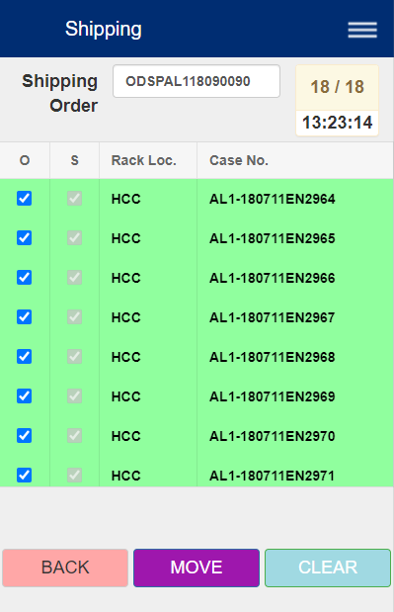
3. MOVING
Before readying the cases for shipping, ensure that:
For all cases, they are marked scanned
For shipping cases, their case barcode and shipping label are scanned
Otherwise, it will display an error message: "Please scan all."
Click the MOVE button. The button will be disabled right after.
If successful, it will display a message indicating success. Scan another shipping order to continue.
Otherwise, it will display an error message such as "...transaction(s) not working. Try it again." In this case, you must reset and start over.

Slide 37
REPACK/SUBASSY MANAGEMENT

Slide 38
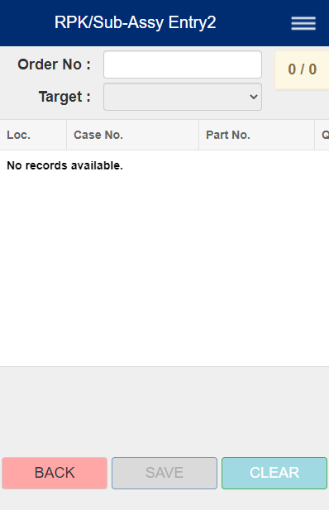
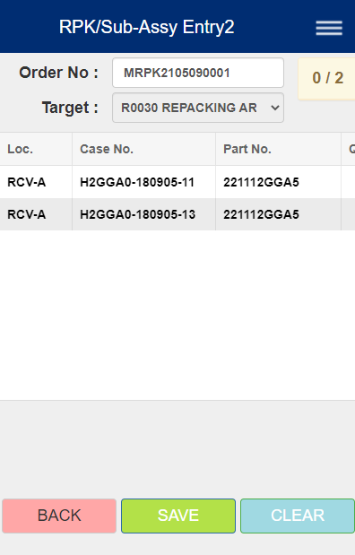
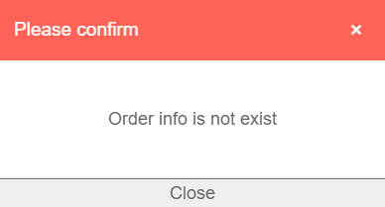
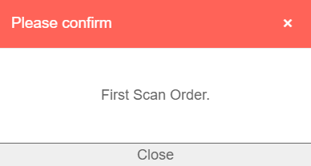
REPACK/SUB-ASSY ENTRY 2
Uses:
Confirm cases entering Repack Entry or Sub-assy Entry Area
To get started
Scan order number barcode (ex: MRPK2105090001)
If valid, the screen will display a list of the cases' information, and Target will automatically be selected.
If invalid, the screen will display the message:
"Order info is not exist"
If a CASE barcode is scanned first, it will display:
"First Scan Order"

Slide 39
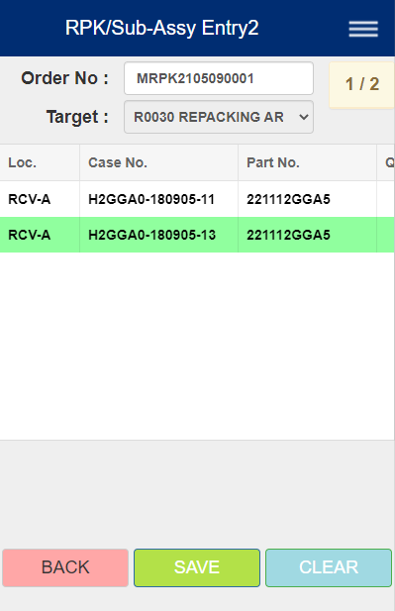
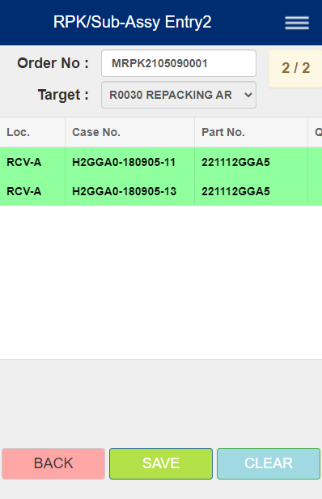
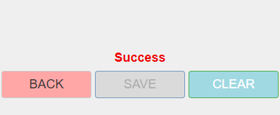
(# Scanned) / (# Cases found)
2. Scan cases
Target will be selected automatically depending on the Order No
Next, scan the CASE numbers listed on the Case No column of the table. Scanned cases will be marked green.
If you scan CASE number not on table, the screen will display a message like:
"Incorrect case […] was scanned."
If you scan CASE number, and screen displays the message "This case is Blocked! Please do not use! Contact Supervisor!", contact your supervisor.
When finished scanning CASES, click the SAVE button.
3. SAVE log
If you click SAVE without scanning any cases, the screen will display:
"Please Scan Case Barcode!" Scan CASES in Step 2.
Otherwise, the PDA will attempt to SAVE records, and will notify if successful or not. If not, it will display a message which were not saved successfully. The SAVE button and scanning cases will be disabled.
Press CLEAR continue with the next Order or try again.
2.
3.

Slide 40



REPACK COMPLETE 2
Uses:
Record log, print info, or update information of a Part going from Repack Entry Area to Repack Complete Area.
1. To get started
Scan a Repack Barcode
ex: [(>*06:P221112GGA5:RK1ON:EN*
If barcode is accepted, the panel will display the Part's information, including the barcode itself as Label.
Otherwise, the screen will display the message below:

Slide 41

2. SAVE (and Print)
After scanning a Repack Barcode, select Printer from the dropdown below the Part Information panel.
Clicking SAVE before selecting printer will result in message:
"Select Printer!"
Click SAVE to save and update data to server.
If SAVE succeeds, then the screen will indicate success and PRINT the information from the selected Printer. The SAVE button and scanning will also be disabled.
If SAVE fails, the screen will display the message: "Insufficient inventory in RPK AREA (R0030)"
After SAVE and Print succeed, press CLEAR to reset screen and continue with the next item.
SAVE

Slide 42


HT REPACK COMPLETE
(# scanned) / (Repack Qty)
Uses:
Record the HT Repack labels for Parts undergoing the Repacking process and coming to Repack Complete Area.
1. To get started
Select from the RPK Type dropdown, which will change the list of items in Part No dropdown
Then, select from the Part No dropdown
Unless "Head" and "LOTNO-NEW" are selected for RPK Type and Part No respectively, the display will display the quantity of items for the Repack.

Slide 43






2. Scanning
Next, scan the correct Lot Barcodes. (ex 05728H300451, A10420162412).
If barcode is accepted, then the table will add the corresponding items to the table, updating the table.
Otherwise, the screen will display a message such as the below:
You can delete a row by selecting a row, then pressing DELETE
*Note: You can manually delete a row by selecting a row on table, then pressing DELETE.
Note: To SAVE, you must scan the correct number of
Please be sure to scan the correct number of LOT Barcodes. Scanning more than the allotted amount will result in message:
"REPACK PARTS SCANNING HITS MAX REPACK QTY!"
SAVE button is enabled when the repack full quantity is scanned

Slide 44

3a. SAVE
After scanning required number of items, you are now able to SAVE and update data.
First, select Printer from the dropdown.
Then, press SAVE (Pressing SAVE without selecting Printer will result in message: "Please select printer/label first!". Please select printer.)
If SAVE is successful, the screen will indicate success, and the information on table will be printed.
If unsuccessful, the screen will indicate failure with message "Transaction is not working. Try it again.", and nothing will be printed.
Afterwards, the SAVE button and scanning are disabled. Press CLEAR to reset screen and continue., or you can go to Step 3b to Print.
3b. Print
Unlike SAVE, you can print if at least one LOT number is accepted.
To print the current information on table, simply:
Select Printer from the dropdown.
Press PRINT. (Pressing PRINT without selecting Printer will result in message: "Please select printer/label first!"

Slide 45

Rpk/sub-assy RETURn
Uses:
Return the leftover parts back to the C/C Rack after the Repack process
Print desired number of labels based on the input quantity
1. To get started:
Select from the "Select Area to Return" dropdown, in which "REPACK AREA" is selected by default.
Scan any of the following barcode labels (should contain Part information):
Unique H/U Label
HT Part
Part No section of 1D barcode (label should start with P)
HMMA LP H/U Label
GLOVIS CKD H/U Label
If barcode is accepted, the screen will display on the Part Information Panel:
Part number and name
RPK/SUB AREA QTY
Return to Rack (user input)
Case No (generated upon successful SAVE on Step 3a)

Slide 46
2. Input Return to Rack Quantity
Enter number on the input box next to Return to Rack Quantity.
If number input is greater than RPK/SUB AREA QTY:
The screen will display a message: "ENTERED EXCEED QUANTITY, PLEASE CHECK RPK/SUB-ASSY AREA INVENTORY!" Then, it will set the number to the value of RPK/SUB AREA QTY
If value of RPK/SUB AREA QTY is 0:
The screen will display a message: "Out of stock at REPACKING/SUB-ASSY AREA." Then, it will set the input blank.
3a. SAVE
After setting Return to Rack Quantity, select Printer from the dropdown.
The SAVE button should be enabled. Press SAVE to start PART RETURN process and record transaction log.
Attempting to SAVE before selecting Printer will result in message: "PLEASE SELECT PRINTER!"
Attempting to Print before SAVE will result in message: "PLEASE SAVE FIRST!"
If SAVE is successful:
The Case No will be filled with the NEW generated Case No
SAVE button will be disabled to prevent duplicate processing.
It will start printing labels according to input quantity.
If SAVE is unsuccessful:
Screen will display message "Insufficient inventory in REPACKING/SUB-ASSY AREA (R0030/S0040)"
SAVE button will be disabled. You will need to press CLEAR to reset and try again.

Slide 47
3b. Reprint with PRINT (Optional)
IMPORTANT: You are not able to use this function until SAVE in Step 3a is successful.
If Step 3a is successful, you can reprint if needed by pressing PRINT.
If printer is not selected, "PLEASE SELECT PRINTER!"
4. Next steps:
User takes the printed labels and attaches one to each PARTIAL CASE
Use CASE MGMT -> CASE STORE menu by using the attached labels. Defective parts are moved to INVENTORY HOLD/INSPECTION.
You can use the PARTIAL CASE for the next repack order

Slide 48


HT LABEL CONFIRM
Uses:
Verify match between Part number and H/U number
1. To get started:
Scan a LOT barcode first, which will fill the Part Scan input.
If other kind of barcode is scanned before filling Part Scan, you will get a message below:
Scan LOT barcode to fill this input

Slide 49




Select from the dropdown
2. Scan H/U
Scan LOT barcode, and the screen will display information on the Part Information panel. You can select from the H/U dropdown to view the H/U case's information.
If there is no info for the selected H/U, you will get the following message:
After selecting the H/U, scan the matching CASE barcode according to the H/U selection. Then, the SAVE button will be enabled.
If the incorrect barcode is scanned, you will get the following message:
Scanned CASE number must match with selected H/U
SAVE data after scanning matching CASE barcode

Slide 50

3. SAVE log
After scanning LOT barcode and matching CASE barcode to the H/U number, press SAVE to save transaction log.
The screen will display whether the transaction has been successfully saved or not. The SAVE button will be disabled, and scanning will be disabled.
Press CLEAR to reset screen and continue.

Slide 51
Inventory management

Slide 52

Inventory count (case)
Uses:
Count the inventory for a particular location according to Loc Type, Cust Cd, and Rack Location
Check which cases are missing (shortage) or extra (overage) based on list of Cases (see Step 1), and update Case Rack data

Slide 53


1. To get started:
Select Loc Type from dropdown (one is selected by default)
Scan Customer Code (ex: OCC)
Select Location from dropdown (if Customer Code is valid)
If ALL inputs are valid, the screen will display a list of Case Nos on table and their Locations.
Next, scan Cases in the selected Case Rack location.
Required fields
(# cases scanned) / (# cases found)

Slide 54


2.
This column keeps track which cases listed have been scanned and confirmed (marked with checkmark)
NOTE: You can also manually uncheck those already checked.
However, you must scan the case again to mark it checked.
2. Checking inventory's case count:
Scan each case in inventory. Scanned cases should be indicated with checkmark
If you scan a case that is NOT listed on display, it will add that case onto the list, and will automatically be marked scanned.
If finished scanning, click SAVE to save data.
3. SAVE
If saving is successful, the SAVE button and scanning will be disabled, requiring you to reset screen by pressing the CLEAR button.
If unsuccessful, the screen will display message indicating failure. Please try again or reset screen.
3.

Slide 55
COMMON ERRORS

Slide 56
COMMON ERRORS
Sometimes you might encounter error messages during processes such as fetching data or saving data:
"Connection error" - PDA may have lost connection with server. You may need to restart PDA, or the network needs to be restarted.
"The application has been updated. It will be reloaded automatically after 3 seconds." - The PDA will automatically restart and reload with the updated version.
"Invalid token" - You may need to login into the PDA again to continue
For menus with the SAVE or MOVE functions:
If the process fails not because of the above reasons in 1., the screen will display a message such as: "Transaction is not working. Try it again." This is most likely due to issues encountered by the server database itself. Please reset and try the process again.

